Slide 1
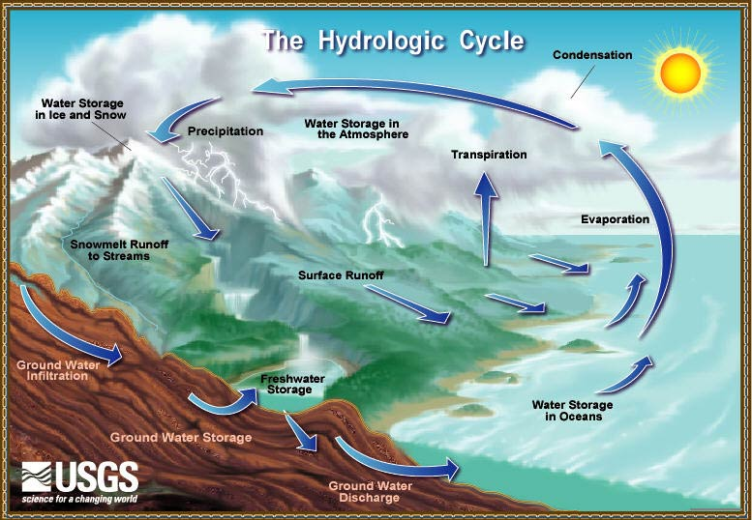
Hydrology

Slide 2
Hydrology
Meteorology
Study of the atmosphere including weather and climate
Surface water hydrology
Flow and occurrence of water on the surface of the earth
Hydrogeology
Flow and occurrence of ground water
Watersheds

Slide 3
Intersection of Hydrology and Hydraulics
Water supplies
Drinking water
Industry
Irrigation
Power generation
Hydropower
Cooling water
Dams
Reservoirs
Levees
Flood protection
Flood plain construction
Water intakes
Discharge and dilution
Wastewater
Cooling water
Outfalls

Slide 4
Engineering Uses of Surface Water Hydrology
Average events (average annual rainfall, evaporation, infiltration...)
Expected average performance of a system
Potential water supply using reservoirs
Frequent extreme events (10 year flood, 10 year low flow)
Levees
Wastewater dilution
Rare extreme events (100 to PMF)
Dam failure
Power plant flooding
Probable maximum flood

Slide 5
Flood Design Techniques
Use stream flow records
Limited data
Can be used for high probability events
Use precipitation records
Use rain gauges rather than stream gauges
Determine flood magnitude based on precipitation, runoff, streamflow
Create a synthetic storm
Based on record of storms

Slide 6
Sources of Data
Stream flows
US geological survey
Http://water.usgs.gov/public/realtime.Html
Http://www-atlas.usgs.gov
National weather service
Http://www.nws.noaa.gov/er/nerfc/
Precipitation
Local rain gage records
Atlas of US national weather service maps
Global extreme events
www.cdc.noaa.gov/usclimate/states.gast.Html
Sixmile Creek
http://www.ncdc.noaa.gov/oa/climate/online/coop-precip.html

Slide 7
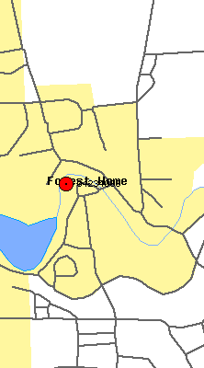
Fall Creek (Daily Discharge)
Snow melt and/or spring rain events!
Calendar year vs Water year? (begins Oct. 1)
http://waterdata.usgs.gov/nwis-w/NY/

Slide 8
Fall Creek Above Beebe Lake (Peak Annual Discharge)
7/8/1935
10/27/1977

Slide 9
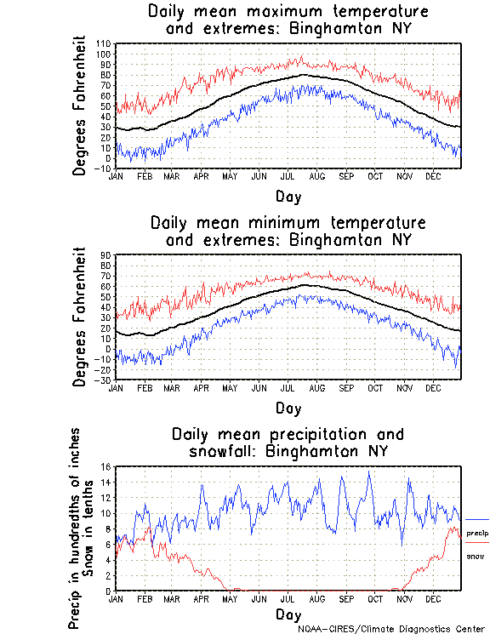
Forecasting Stream Flows
Natural processes - not easily predicted in a deterministic way
We cannot predict the monthly stream flow in Fall Creek
We will use probability distributions instead of predictions
10 year daily average
Seasonal trend with large variation

Slide 10
Stochastic Processes
Stochastic: a process involving a randomly determined sequence of observations, each of which is considered as a sample of one element from a probability distribution
Rather than predicting the exact value of a variable in a time period of interest, describe the probability that the variable will have a certain value
For extreme events the ______ of the probability distribution is very important
shape

Slide 11
Fall Creek: Stream Flow Probability Distribution
What fraction of the time is the flow between 2 and 5 m³/s?
mean 5.3 m³/s
standard deviation 7.5 m³/s
Unit area
Tail!!!
Events in bin
Total Events* bin width

Slide 12
Prob and Stat
Laws of probability (for mutually exclusive and independent events)
P(A or B) = P(A) + P(B)
P(A and B) = P(A) · P(B)
Common Hydrologic Nomenclature
Return period (inverse of probability of occurring in one year)
100 year flood is equivalent to
Q_{7,10}
1% probability per year
7 day low flow with 10 year return period

Slide 13
Choice of Return Periods: RISK!!!
How do you choose an acceptable risk?
Crops
Parking lot
Water treatment plant
Nuclear power plant
Large dam
What about long term changes?
Global climate change
Development in the watershed
Construction of Levees
Potential harm
Acceptable risk

Slide 14
Design Flood Exceedance
Example: what is the probability that a 100 year design flood is exceeded at least once in a 50-year project life (small dam design)
=______________________
Not (safe for 50 years)
(p = probability of exceedance in one year)
probability of safe performance for one year
probability of safe performance for two years
probability of safe performance for n years
probability of exceedance in n years
probability that 100 year flood exceeded at least once in 50 years
Notes:
probability that 100 year flood occurs at least once in 100 years ° 1!
P(exceedance) = 1 - (1 - 0.01)100 = 0.63

Slide 15
Probability of exceeding 100 year flood in only one year in 50 years?
Find probability that we get at least one 100 year flood this year and none in any other years
But it could happen in any year…
(p = probability of exceedance this year)
probability of safe performance for remaining years
probability of flood this year and safe for remaining years
Number of combinations
probability that 100 year flood exceeded only one year in 50 years
Why isn’t this the probability of exactly one 100 year flood?

Slide 16
Empirical Estimation of 10 Year Flood
Fall Creek Annual Peak Flow Record
Sort annual max discharge in decreasing order
Plot vs. Where N is the number of years in the record
How often was data collected?
10 year flood
2 year flood

Slide 17
Extreme Events
Suppose we can only accept a 1% chance of failure due to flooding in a 50 year project life. What is the return period for the design flood?
Given 50 year project life, 1% chance of failure requires the probability of exceedance to be _____ in one year
Extreme event! Return period of _____ years!
0.02%
5000
Notes:
Suppose we can only accept a 1% chance of failure due to flooding in a 50 year project life. What is the return period for the design flood?
Given 50 year project life, 1% chance of failure requires the probability of exceedance to be 0.02% in one year
Extreme event! Return period of 5000 years!

Slide 18
Reflections on predicting extreme floods
Annual peak flows are caused by different mechanisms in different years
Snow melt
Spring rains on saturated ground with no transpiration
Summer thunderstorms
Hurricanes
Each of these mechanisms has its own probability distribution
We are plotting apples and oranges on the same graph!
And we are trying to predict the number of watermelons!
If watermelons have a recurrence interval of 1000 years, then it is likely that Fall Creek hasn’t had a watermelon in the historic record
Could look for watermelons in other locations

Slide 19
Extreme Events
Low probability of failure requires the probability of failure in one year to be very very low
The design event has most likely not occurred in the historic record
Nuclear power plant on bank of river
Designed for flood with 100,000 year return period, but have observations for 100 years

Slide 20
Quantifying Extreme Events
Use stream flow records to describe distribution including skewness and then extrapolate
Adjust gage station flows to project site based on watershed area
Use similar adjacent watersheds if stream flow data is unavailable for the project stream
Use rainfall data and apply a model to estimate stream flow
Use local rain gage data
Use global maximum precipitation
Estimate probable maximum precipitation for the site

Slide 21
Extreme Extrapolation
We don’t have enough data to really know what the _____ of the distribution looks like
Added complications of
Climate change (by humans or otherwise)
Human impact on environment (deforestation and development may cause an increase in the probability of extreme events)
tail
Where are we going

Slide 22
Alternative Methods to Predict Stream Flows
Compare with stream flows in similar watershed
Assume similar runoff (________________)
Scale stream flow by __________________
What about peak flow prediction? __________
Use rainfall data and a model that describes
Infiltration
Storage
Evaporation
Runoff
Can we use Cascadilla Creek to predict Fall Creek?
fraction of rainfall
size of watershed
f(terrain)

Slide 23
Local Rain Gage Records (Point Rainfall)
Spatial variation
Maximum point rainfall intensity tends to be greater than maximum rainfall intensity over a large area!
Rain gage considered accurate up to 10 square miles
Correction factor (next slide)
Various methods to compute average rainfall based on several gages
Rain gage size

Slide 24
Rain Gage Area Correction Factor
Storm duration
Technical Paper 40 NOAA

Slide 25
US National Weather Service Maps
Frequency - duration - depth (at a point)
10-year 1-hour rainfall (Ithaca - 1.6”)
10-year 6-hour rainfall (Ithaca - 2.5”)
10-year 24-hour rainfall (Ithaca - 3.9”)
http://www.srh.noaa.gov/lub/wx/precip_freq/precip_index.htm
Probable maximum 24-hr rainfall
Ithaca - 20”
Global record - 50”

Slide 26
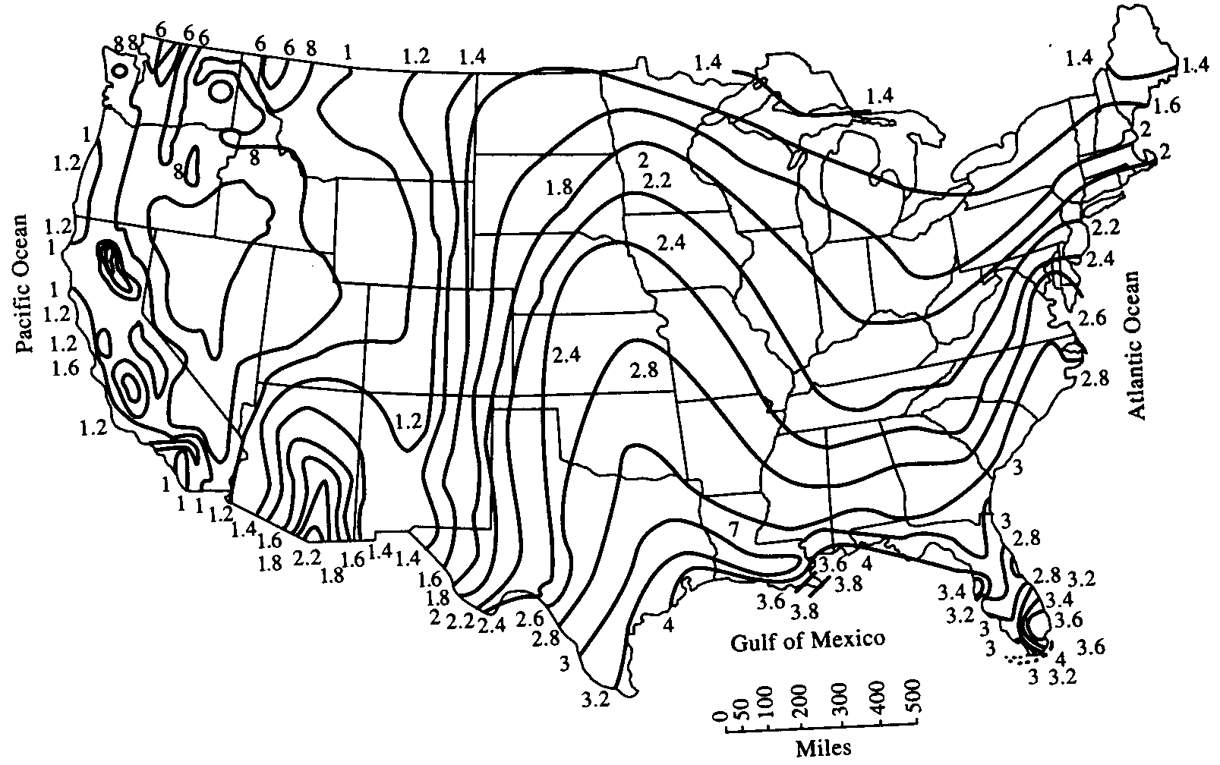
10-year 1-hour Rainfall

Slide 27
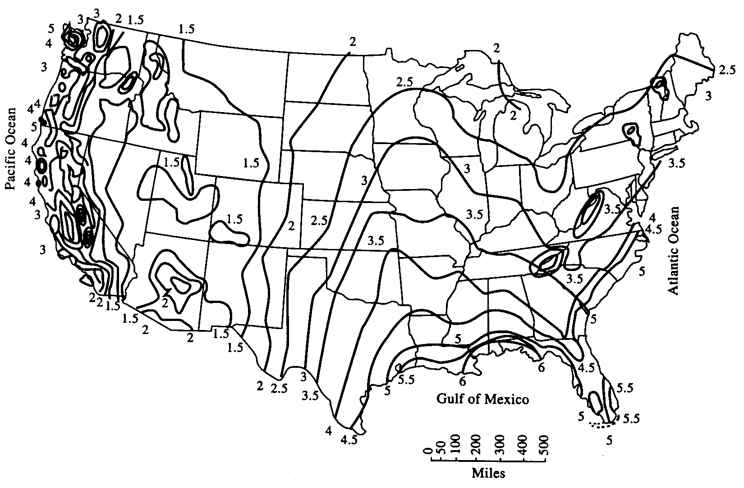
10-year 6-hour Rainfall

Slide 28
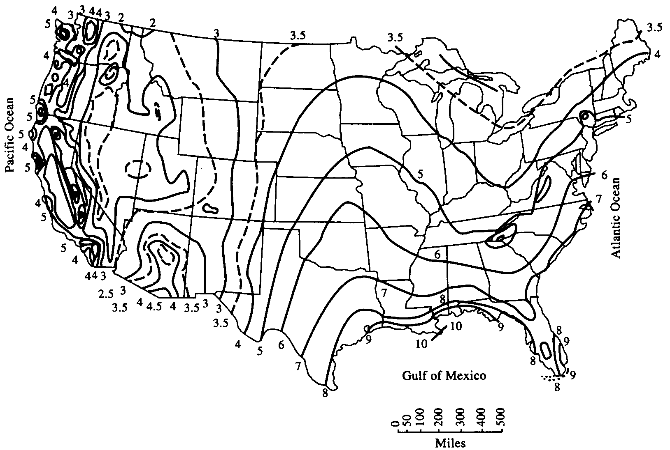
10-year 24-hour Rainfall

Slide 29
Global Extreme Events
Short duration storms can occur anywhere (thunderstorms)
4” in 8 minutes
Check out Pennsylvania!
Long duration storms occur in areas subject to monsoon rainfall
150” in 7 days
Check out India!

Slide 30
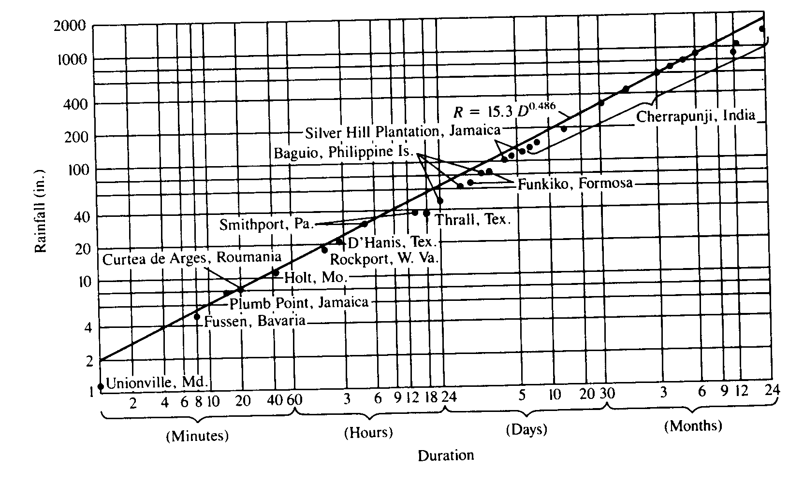
Global Extreme Events
http://www.nws.noaa.gov/oh/hdsc/max_precip/maxprecp.htm

Slide 31
Global Maximum Precipitation
http://www.nws.noaa.gov/oh/hdsc/max_precip/maxprecp.htm

Slide 32
Probable Maximum Precipitation (PMP)
Used as a design event when a large flood would result in hazards to life or great economic loss
Large dams upstream from population centers
Nuclear power plants
Based on observed storms where R is in inches and D is in hours
Or estimated by hydrometeorologist
Created by adjusting actual relative humidity measured during an intense storm to the maximum relative humidity

Slide 33
Synthetic Storm Design
Total precipitation of design storm is a function of:
Frequency: f(risk assessment)
Duration: f(time of concentration)
Area: watershed area
Time distribution of rainfall
Small dam or other minor structures
Uniform for duration of storm
Large watershed or region
Must account for storm structure
Can construct synthetic storm sequence
How often are you willing to have conditions that exceed your design specifications?

Slide 34
Summary: Synthetic Flood Design
Select storm parameters
Depth = f(frequency, duration, area)
Time distribution
Create synthetic storm using these sources
Local rain gage records
Atlas of US national weather service maps
Global extreme events
Now we have precipitation, but we want depth of water in a stream!
See pages 314-315 in Chin for a more complete description

Slide 35
Flood Design Process
Create a synthetic storm
Estimate the infiltration, depression storage, and runoff
Estimate the stream flow
We need models!

Slide 36
Methods to Predict Runoff
Scientific (dynamic) hydrology
Based on physical principles
Mechanistic description
Difficult given all the local details
Engineering (empirical) hydrology
“Rational formula”
Soil-cover complex method
Many others

Slide 37
Engineering (Empirical) Hydrology
Based on observations and experience
Overall description without attempt to describe details
Mostly concerned with various methods of estimating or predicting precipitation and streamflow

Slide 38
“Rational Formula”
p. 359 in Chin
Q_{p} = CiA
Q_{P} = peak runoff
C is a dimensionless coefficient
C=f(land use, slope)
http://ceeserver.Cee.Cornell.Edu/mw24/cee332/scs_cn/runoff_coefficients.Htm
i = rainfall intensity [L/T]
A = drainage area [L²]
Example

Slide 39
“Rational Formula” - Method to Choose Rainfall Intensity
Intensity = f(storm duration)
Expectation of stream flow vs. Time during storm of constant intensity
Q
Q_{p}
Outflow point
t
Watershed divide
t_{c}
Classic Watershed

Slide 40
“Rational Formula” - Time of Concentration (T_{c})
Time required (after start of rainfall event) for most distant point in basin to begin contributing runoff to basin outlet
T_{c} affects the shape of the outflow hydrograph (flow record as a function of time)

Slide 41
Time of Concentration (T_{c}): Kirpich
T_{c} = time of concentration [min]
L = “stream” or “flow path” length [ft]
h = elevation difference between basin ends [ft]
Watch those units!

Slide 42
Time of Concentration (T_{c}): Hatheway
T_{c} = time of concentration [min]
L = “stream” or “flow path” length [ft]
S = mean slope of the basin
N = Manning’s roughness coefficient (0.02 smooth to 0.8 grass overland)

Slide 43
“Rational Formula” - Review
Estimate t_{c}
Pick duration of storm = t_{c}
Estimate point rainfall intensity based on synthetic storm (US national weather service maps)
Convert point rainfall intensity to average area intensity
Estimate runoff coefficient based on land use
Why is this the max flow?

Slide 44
“Rational Formula” - Fall Creek 10 Year Storm
Area = 126 mi² = 3.512 x 10⁹ ft² = 326 km²
L ­ 15 miles ­ 80,000 ft
h ­ 800 ft (between Beebe lake and hills)
t_{c} = 274 min = 4.6 hours
6 hr storm = 2.5” or 0.42”/hr
Area factor = 0.87 therefore i = 0.42 x 0.87 = 0.36 in/hr
NWS map
Area correction

Slide 45
“Rational Formula” - Fall Creek 10 Year Storm
C ­ 0.25 (moderately steep, grass-covered clayey soils, some development)
Q_{p} = CiA
Q_{P} = 7300 ft³/s (200 m³/s)
Empirical 10 year flood is approximately 150 m³/s
Runoff Coefficients

Slide 46
“Rational Method” Limitations
Reasonable for small watersheds
The runoff coefficient is not constant during a storm
No ability to predict flow as a function of time (only peak flow)
Only applicable for storms with duration longer than the time of concentration
< 80 ha

Slide 47
Flood Design Process (Review)
Create a synthetic storm
Estimate infiltration and runoff
Soil-cover complex
Estimate the streamflow
“Rational method”
Hydrographs

Slide 48
Runoff As a Function of Rainfall
Not stream flow!
Exercise: plot cumulative runoff vs. Cumulative precipitation for a parking lot and for the engineering quad. Assume a rainfall of 1/2” per hour for 10 hours.
Parking lot
?
Engineering Quad
Accumulated runoff
Accumulated rainfall

Slide 49
Infiltration
Water filling soil pores and moving down through soil
Depends on - soil type and grain size, land use and soil cover, and antecedent moisture conditions (prior to rainfall)
Usually maximum at beginning of storm (dry soils, large pores) and decreases as moisture content increases
Vegetation (soil cover) prevents soil compaction by rainfall and increases infiltration

Slide 50
Soil-Cover Complex Method
US NRCS (Natural Resources Conservation Service) “curve-number” method
Accounts for
Initial abstraction of rainfall before runoff begins
Interception
Depression storage
Infiltration
Infiltration after runoff begins
Appropriate for small watersheds

Slide 51
Soil-Cover Complex Method
CN (curve number) is a value assigned to different soil types based on
Soil type
Land use
Antecedent conditions
CN (curve number) range
0 to 100 (actually %)
0 → low runoff potential
100 → high runoff-potential
f(initial moisture content)

Slide 52
CN = F(soil Type, Land Use, Hydrologic Condition, Antecedent Moisture)
antecedent moisture
I - dry soil moisture levels
II - normal soil moisture levels
III - wet soil moisture levels
Land use
Crop type
Woods
Roads
Hydrologic condition
Poor - heavily grazed, less than 50% plant cover
Fair - moderately grazed, 50 - 75% plant cover
Good - lightly grazed, more than 75% plant cover
Curve Number Tables

Slide 53
Soil-Cover Complex Method
p_{excess} = accumulated precipitation excess (inches)
P = accumulated precipitation depth (inches)
Empirical equation
rain that will become runoff
if
then
else

Slide 54
Soil-Cover Complex Method: Graph
Parking lot

Slide 55
Soil-cover Complex Method
Choose CN based on soil type, land use, hydrologic condition, antecedent moisture
Subareas of the basin can have different CN
Compute area weighted averages for CN
Choose storm event (precipitation vs. time)
Calculate cumulative rainfall excess vs. time
Calculate incremental rainfall excess vs. time (to get runoff produced vs. time)

Slide 56
Stream Flow
≠
Runoff vs. Time ___ stream flow vs. Time
Water from different points will arrive at gage station at different times
Need a method to convert runoff into stream flow

Slide 57
Hydrographs
Graph of stream flow vs. time
Obtained by means of a continuous recorder which indicates stage vs. time (stage hydrograph)
Transformed to a discharge hydrograph by application of a rating curve
Typically are complex multiple peak curves
Available on the web
Real Hydrographs

Slide 58
Hydrographs
Introduction
There are many types of hydrographs
I will present one type as an example
This is a science with lots of art!
Assumptions
Linearity - hydrographs can be superimposed
Peak discharge is proportional to runoff rate*
* Required for linearity

Slide 59
Hydrograph Nomenclature
storm of Duration D
Precipitation
P
t_{l}
t_{p}
peak flow
Discharge
Q
baseflow
new baseflow
w/o rainfall
Time

Slide 60
NRCS* Dimensionless Unit Hydrograph
Unit = 1 inch of runoff (not rainfall) in 1 hour
Can be scaled to other depths and times
Based on unit hydrographs from many watersheds
1.000
0.800
Q/Qp
0.600
0.400
0.200
0.000
0
1
2
3
4
5
* Natural Resources Conservation Service
t/tp

Slide 61
NRCS Dimensionless Unit Hydrograph
t_{p} the time from the beginning of the rainfall to peak discharge [hr]
t_{l} the lag time from the centroid of rainfall to peak discharge [hr]
D the duration of rainfall [hr] (D < 0.25 t_{l}) (use sequence of storms of short duration)
Q_{p} peak discharge [cfs]
A drainage area [mi²]
L length to watershed divide in feet
S average watershed slope
CN NRCS curve number

Slide 62
Fall Creek Unit Hydrograph
L ­ 15 miles ­ 80,000 ft
S ­ 0.01
CN ­ 70 (soil C, woods)
t_{l} ­ 14 hr
Let D = 1 hr
t_{p} ­ 14.5 hr
Area = 126 mi²
Q_{p} ­ 4200 cfs
120 m³
How much runoff?________
1 inch

Slide 63
Storm Hydrograph
Calculate incremental runoff for each hour during storm using soil-cover complex method
Scale NRCS dimensionless unit hydrograph by
Peak flow
Time to peak
Runoff depth for each hour (relative to 1 inch)
Add unit hydrographs for each hour of the storm (shifted in time) to get storm hydrograph

Slide 64
Addition of Hydrographs
Q_{max} = 0.2(4200 cfs) = 24 m³/s

Slide 65
What are NRCS Limitations?
No snow melt
No rain on snow
Lumped model (infiltration/runoff over entire watershed is characterized by a single number)
Stream flow model is simplistic (reduced to a time of concentration)

Slide 66
Hydrology Summary
Techniques to predict stream flows
Historical record (USGS)
Extrapolate from adjoining watersheds
Estimate based on precipitation
Rain gages
Rainfall
Synthetic Storm
Rational Method
Runoff
NRCS Soil Cover Complex Method
Stream Flow
NRCS Hydrograph

Slide 67
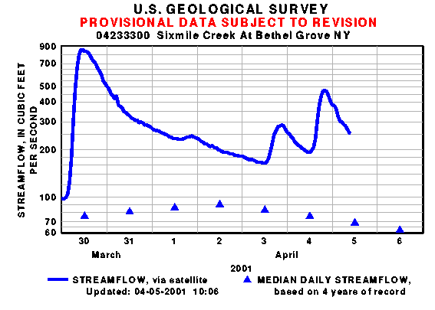
Sixmile Creek
04233300-- Sixmile Creek At Bethel Grove NY
Runoff events caused by...
Snow melt
Rainfall
http://waterdata.usgs.gov/ny/nwis/uv?site_no=04233300

Slide 68
Where Are We Going?
We want to protect against system failure during extreme events (floods and droughts)
Need tools to predict magnitude of those events
We have two data sources
Stream gage stations
Rain gage
What do you do if you don’t have either data source?

Slide 69
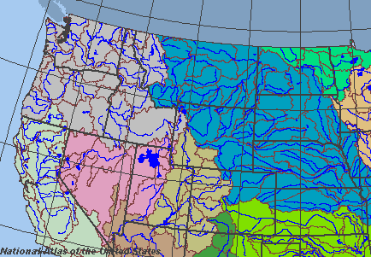
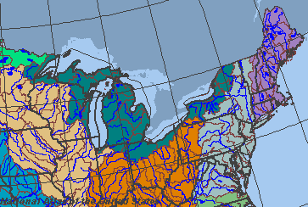
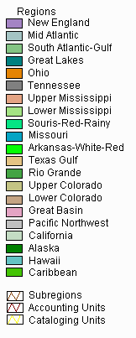
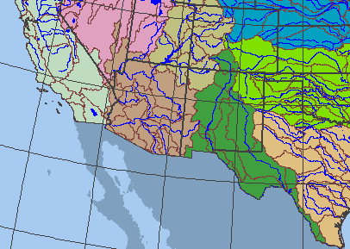
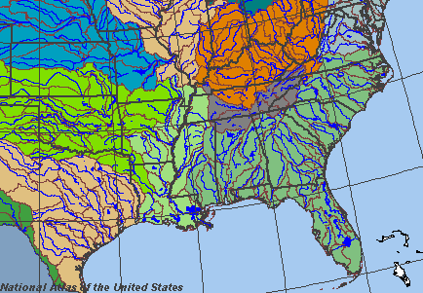
Watersheds of the United States

Slide 70
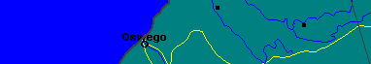
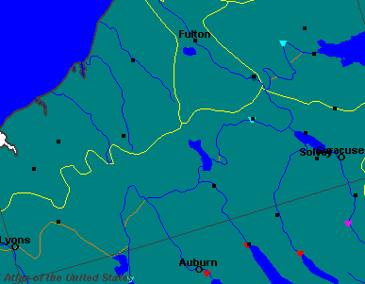
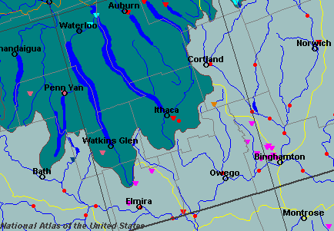
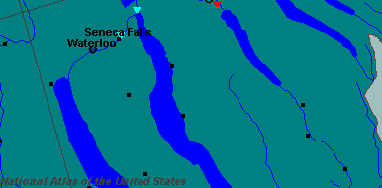
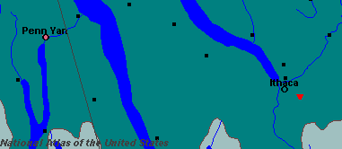
Where Does Our Water Go?
http://www-atlas.usgs.gov

Slide 71
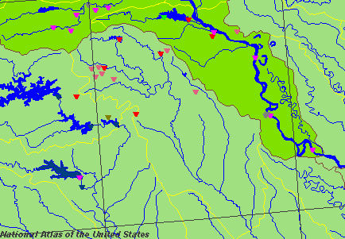
Classic Watershed
Lower Mississippi Region Lower Red-Ouachita

Slide 72
Rain Gage Size

Slide 73
Rational Formula Example
Suppose it rains 0.25” in 30 minutes on Fall Creek watershed and runoff coefficient is 0.25. What is the peak flow?
Peak flow in record was 450 m³/s. What is wrong?
Method not valid for storms with duration less than t_{c}.

Slide 74
NRCS Unit Hydrograph Example
Suppose it rains 1” in 30 minutes on Fall Creek watershed and produces 1/4” of runoff. What is the peak flow?
Peak flow in record was 450 m³/s. What is wrong?
Method not valid for storms with duration less than t_{c}.

Slide 75
Fall Creek Unit Hydrograph
L ­ 15 miles ­ 80,000 ft
S ­ 0.01
CN ­ 70 (soil C, woods)
T_{l} ­ 14 hr
Let D = 0.5 hr
T_{p} ­ 14.25 hr
Area = 126 mi²
Q_{p} ­ 4200 cfs

Slide 76
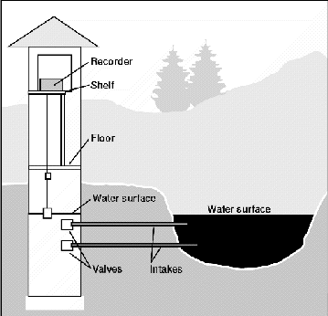
Stage Measurements
http://h2o.er.usgs.gov/public/pubs/circ1123/collection.html#HDR8
Stilling well
Bubbler system: the shelter and recorders can be located hundreds of feet from the stream. An orifice is attached securely below the water surface and connected to the instrumentation by a length of tubing. Pressurized gas (usually nitrogen or air) is forced through the tubing and out the orifice. Because the pressure in the tubing is a function of the depth of water over the orifice, a change in the stage of the river produces a corresponding change in pressure in the tubing. Changes in the pressure in the tubing are recorded and are converted to a record of the river stage.
Stilling well

Slide 77
Discharge Measurements
The USGS makes more than 60,000 discharge measurements each year
Most commonly use velocity-area method
The width of the stream is divided into a number of increments; the size of the increments depends on the depth and velocity of the stream. The purpose is to divide the section into about 25 increments with approximately equal discharges. For each incremental width, the stream depth and average velocity of flow are measured. For each incremental width, the meter is placed at a depth where average velocity is expected to occur. That depth has been determined to be about 0.6 of the distance from the water surface to the streambed when depths are shallow. When depths are large, the average velocity is best represented by averaging velocity readings at 0.2 and 0.8 of the distance from the water surface to the streambed. The product of the width, depth, and velocity of the section is the discharge through that increment of the cross section. The total of the incremental section discharges equals the discharge of the river.

Slide 78
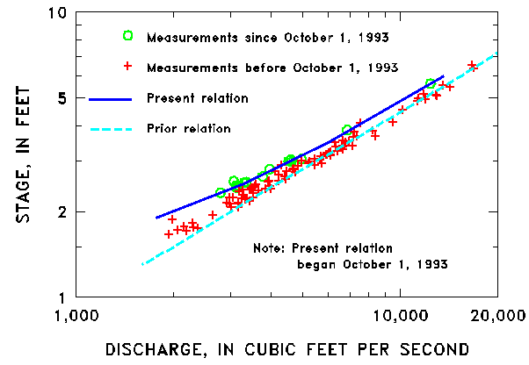
Stage-discharge: An Ever-changing Relationship
Sediment and other material may be eroded from or deposited on the streambed or banks
Growth of vegetation along the banks and aquatic growth in the channel itself can impede the velocity, as can deposition of downed trees in the channel
Ice and snow can produce large changes in stage-discharge relations, and the degree of change can vary dramatically with time

Slide 79
Storm Hydrograph Wynoochee River Near Montesano in Washington
Flow (m³/s)

